Slide 1
ElectroChem Cell
CAD Models – Dimension
Date Updated: July 6, 2020

Slide 2
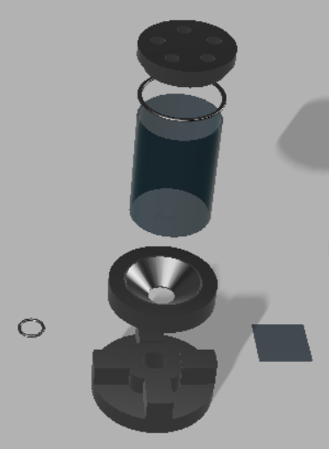
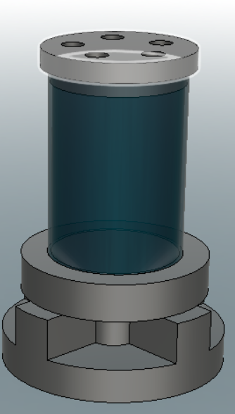
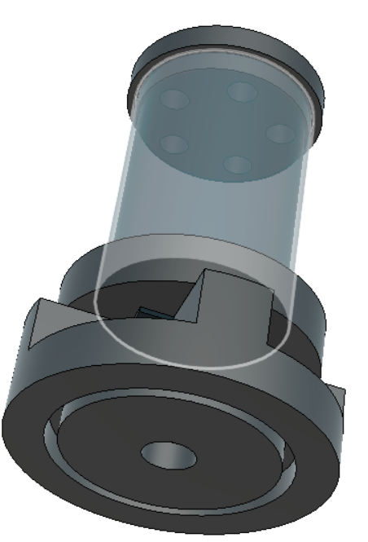
Full Cell Assembly

Slide 3
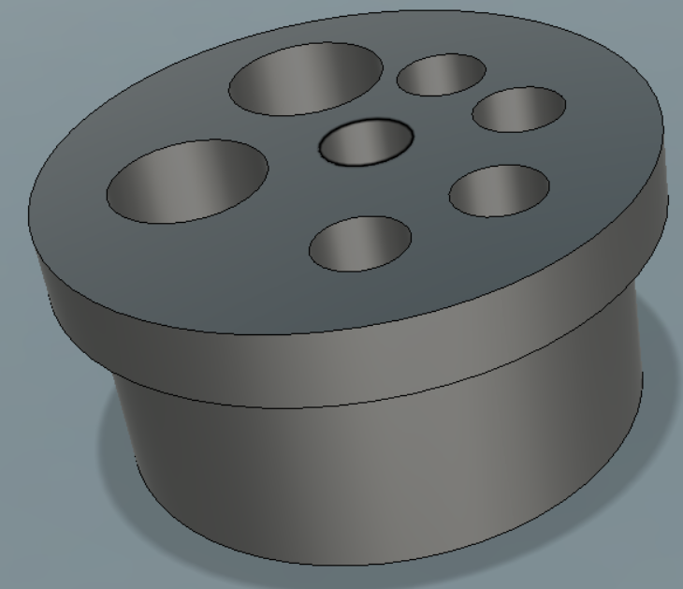
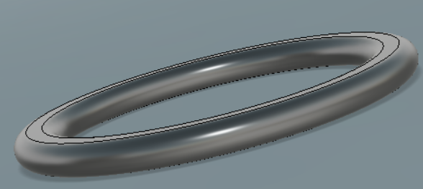
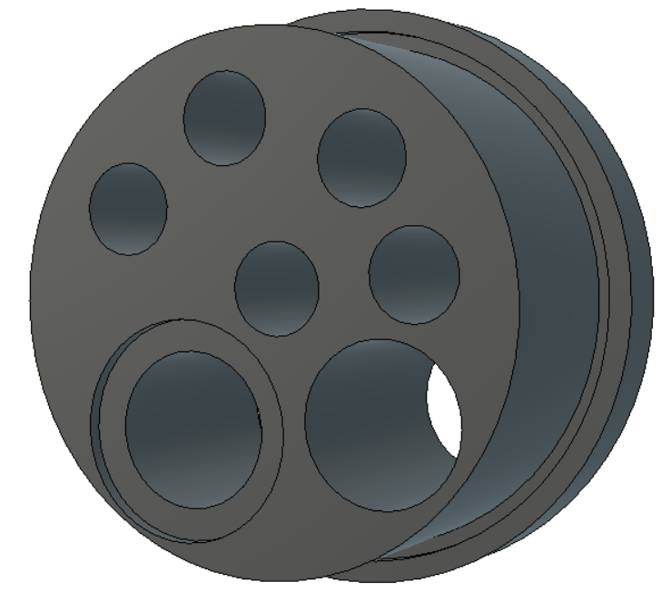
Top Cap - CAD Model
Dimensions
Probe Holder Hole Diameter = 6mm
Outer Diameter = 40mm
O-ring = 35.2 mm
  Used to seal into glass tube
O-Ring Placeholder Diameter = 35.2 mm
  Groove Diameter = 1mm (not shown)
Inner Diameter = 34mm; 10mm into the Chamber

Slide 4
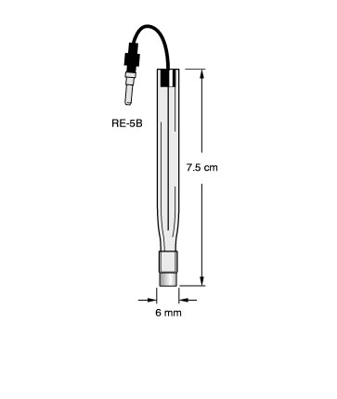
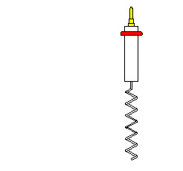
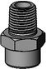
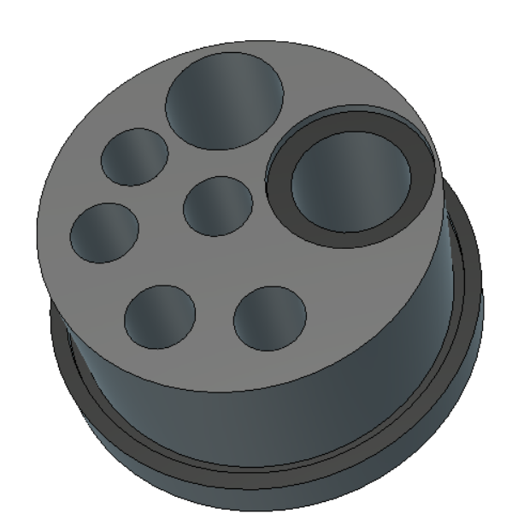

Top Cap – Various Probe Fittings
(Note: Taps not shown)
Spray nozzle for cell washing
(10.28mm Diameter)
Embedded Area for Spray Nozzle Bolt
Tube Insertion for electrolyte removal
(10.6mm Diameter)
Actual scale
120⁰ spray
Reference Electrode
(6mm Diameter)
Through Hole
(For Pipetting Fluids)
(6mm Diameter)
Counter Electrode
(6mm Diameter)
Extra Fittings as needed
(6mm Diameter)
* Fittings can be moved in final design to allow for more space for different probes

Slide 5
Various Probe Fittings – Detailed Information
Reference Electrode – 6 mm diameter, no threading just a thru-hole - https://www.basinc.com/products/471
b) Counter Electrode – 6 mm diameter, no threading just a thru-hole - https://www.basinc.com/products/794
c) Tube insertion – ¼-28 threads – For liquid handling pump removal of electrolyte prior to cell wash
        https://www.vici-jour.com/fittings/flangeless-peek.php
d) Thru-hole – 6 mm diameter (for the robot to pipette liquid)
Spray Nozzle - https://www.mcmaster.com/spray-nozzles/material~plastic/spray-pattern~full-cone/
      - Various other designs possible
f) 1-2 more holes that are ~6 mm diameter if possible? Whatever will fit without “cramming” the piece

Slide 6
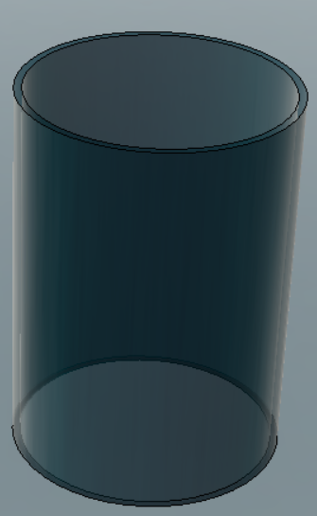
Glass Chamber – CAD Model
Dimensions
Height – 50mm
Outer Diameter – 38mm
Inner diameter – 35.2mm
To be held on top and bottom piece via o-ring seal
Allows for easy removal for acid-cleaning in between campaigns

Slide 7

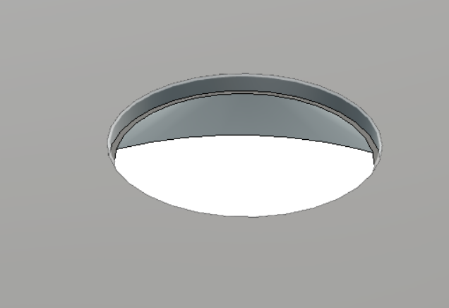
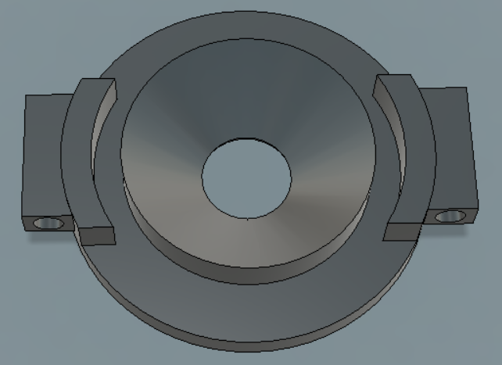
Bottom Casing - CAD Model
Dimensions
Open Hole Diameter =10mm
Outer Diameter = 50mm
Embedded O-Ring Placeholder Diameter = 10mm ; 1mm into casing
O-Ring Seal Wrapped around Conical center
  Seals the chamber to the casing (not shown)
Bottom
Top
Glass Chamber will fit onto bottom chamber via o-ring seal

Slide 8
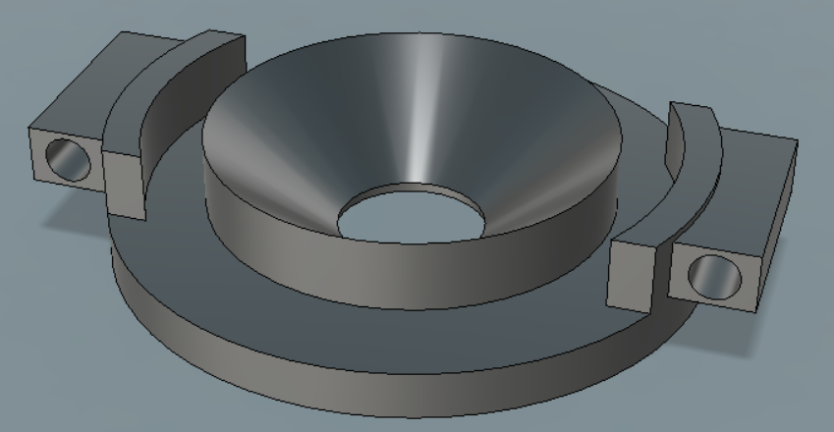
Bottom Casing - CAD Model
Bottom Casing Redesigned to have “wings”
Pneumatic lift will have extended arms that fit inside designed holes (4mm diameter)
Wing Sizing = 18mm x 5mm (5mm Extruded from base)

Slide 9
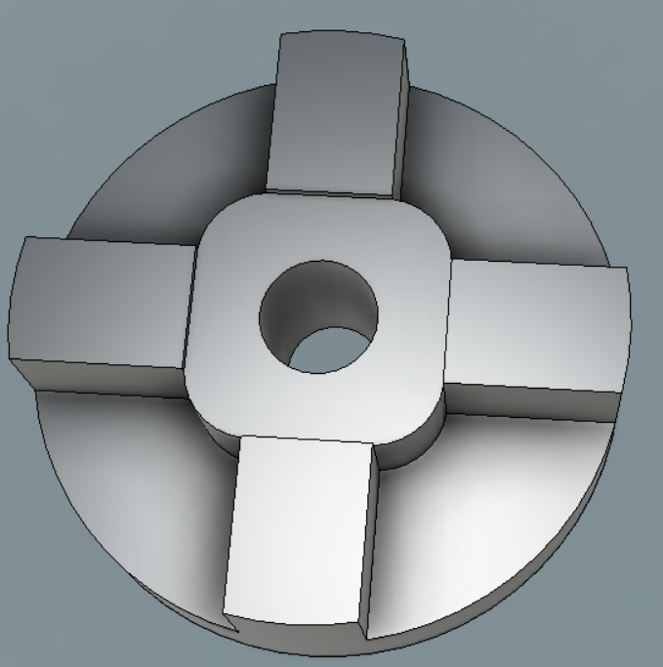
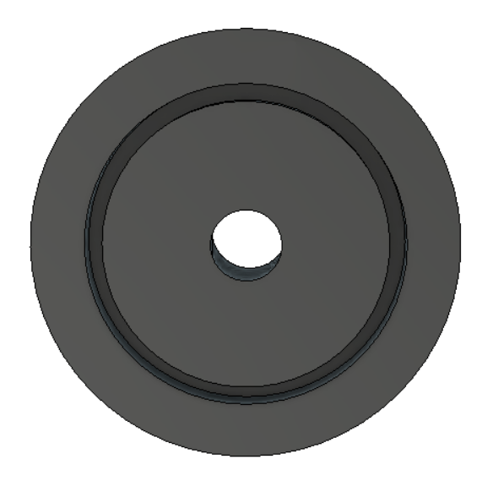
Sample Casing Redesigned CAD Model
Dimensions
Outer Diameter – 60mm
Drain Diameter – 10mm
Corner Clearance – 10mm
Square Glass Slide Bed – 26mm x 26mm
Attachment to tube
Top
Bottom
To be separated from rest of cell via pneumatic lift
Holds glass slide in place and allows for N9 to add and remove glass slide

Slide 10
EMAP – Pneumatic Lift
Date Updated: July 6th , 2020

Slide 11
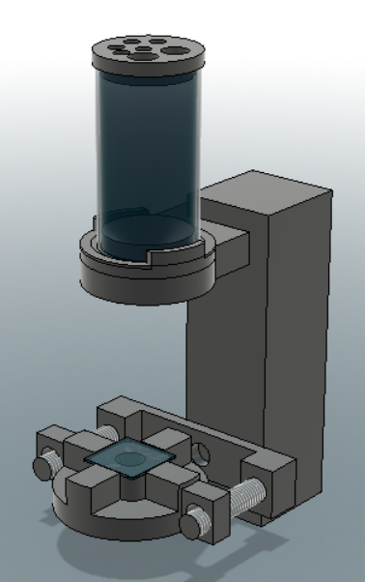
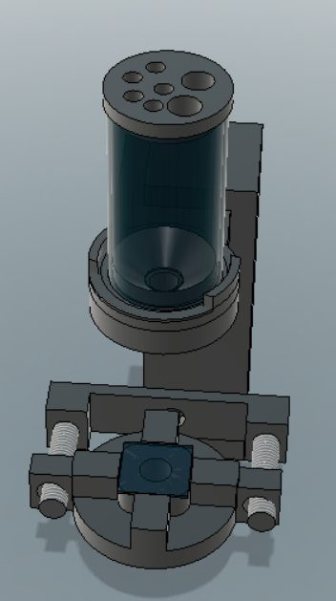
Assembled CAD Model
During slide add/remove
Pieces together during operation
Stationary
Chamber with
pneumatic
actuator
Separation Plane
Moves linearly
Movement + pressure
controlled via pneumatics

Slide 12
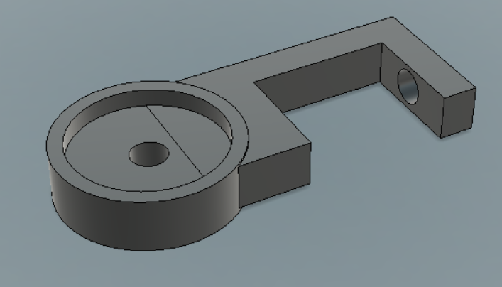
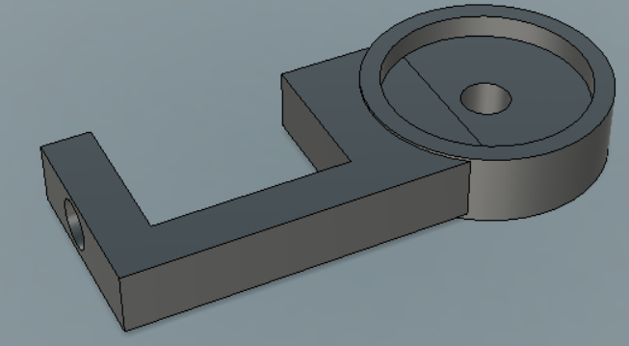
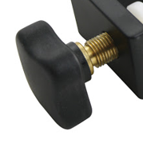
Pneumatic Actuator – Top Cell Piece Holder
A screw with a cap can be used to physically tighten the pedestal to a custom height.
*Model not to scale, based off assumptions

Slide 13
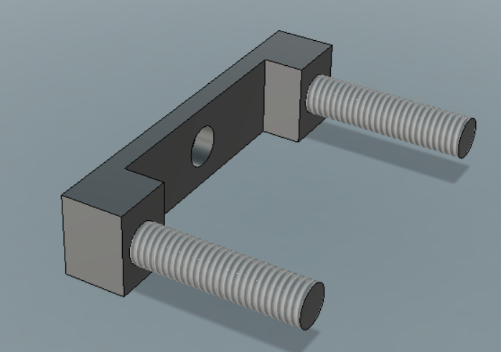
Pneumatic Actuator – Bottom Cell Piece Holder

